Slide 1
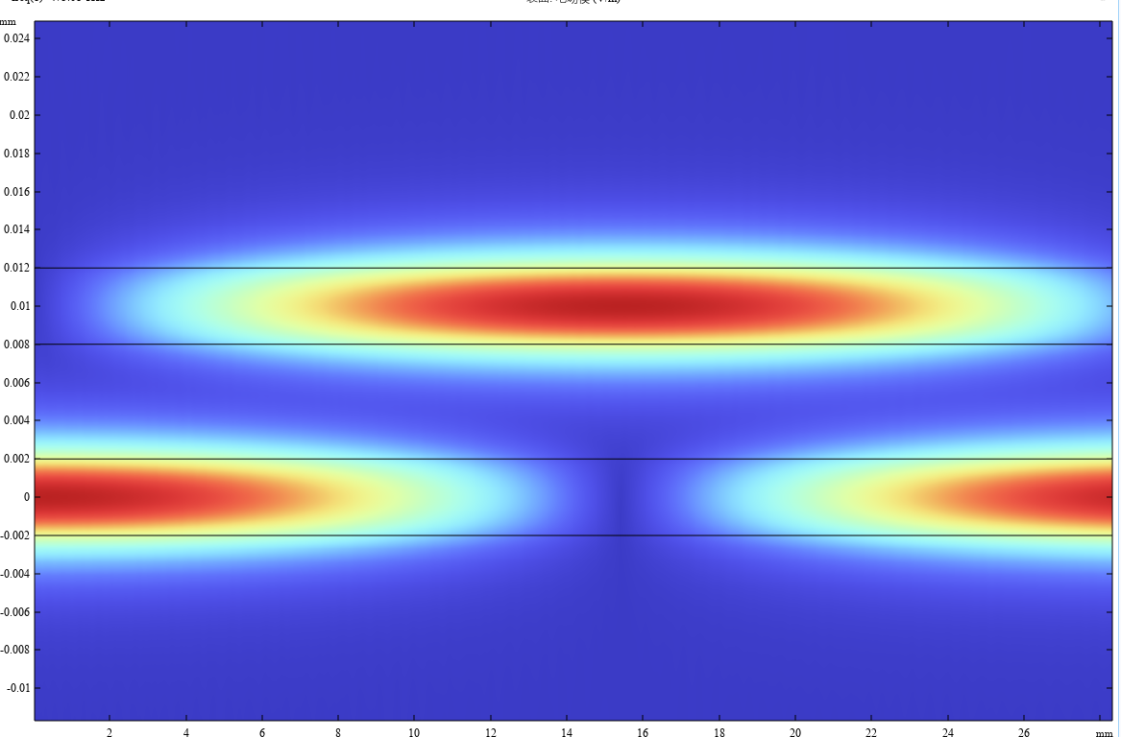
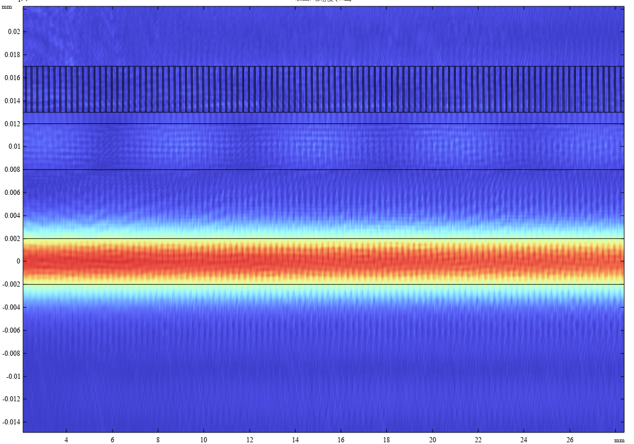
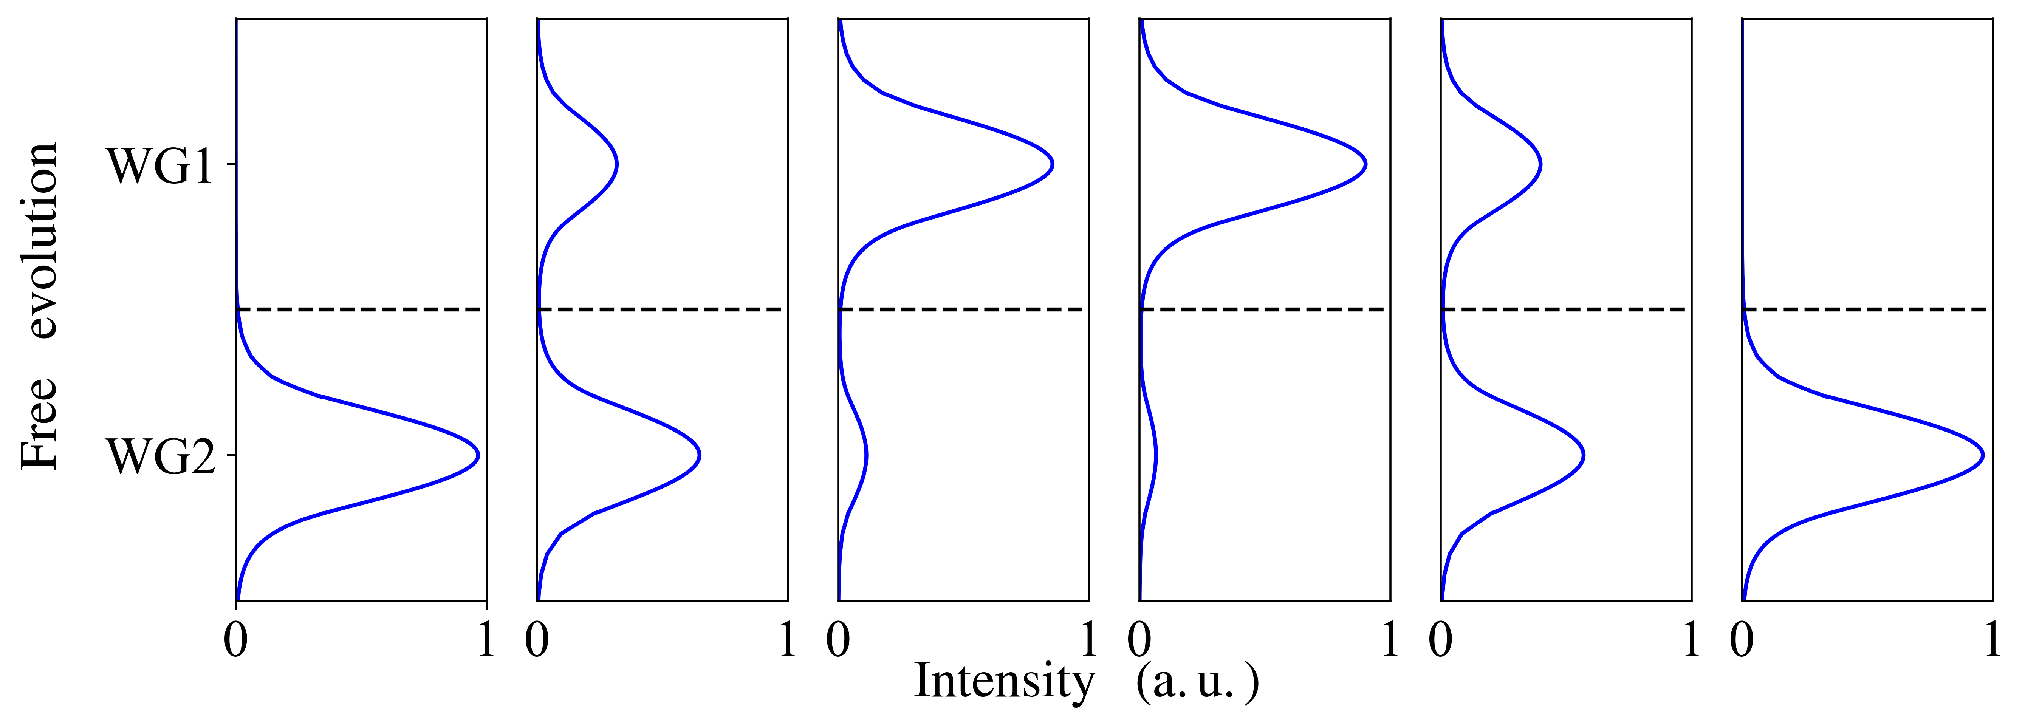
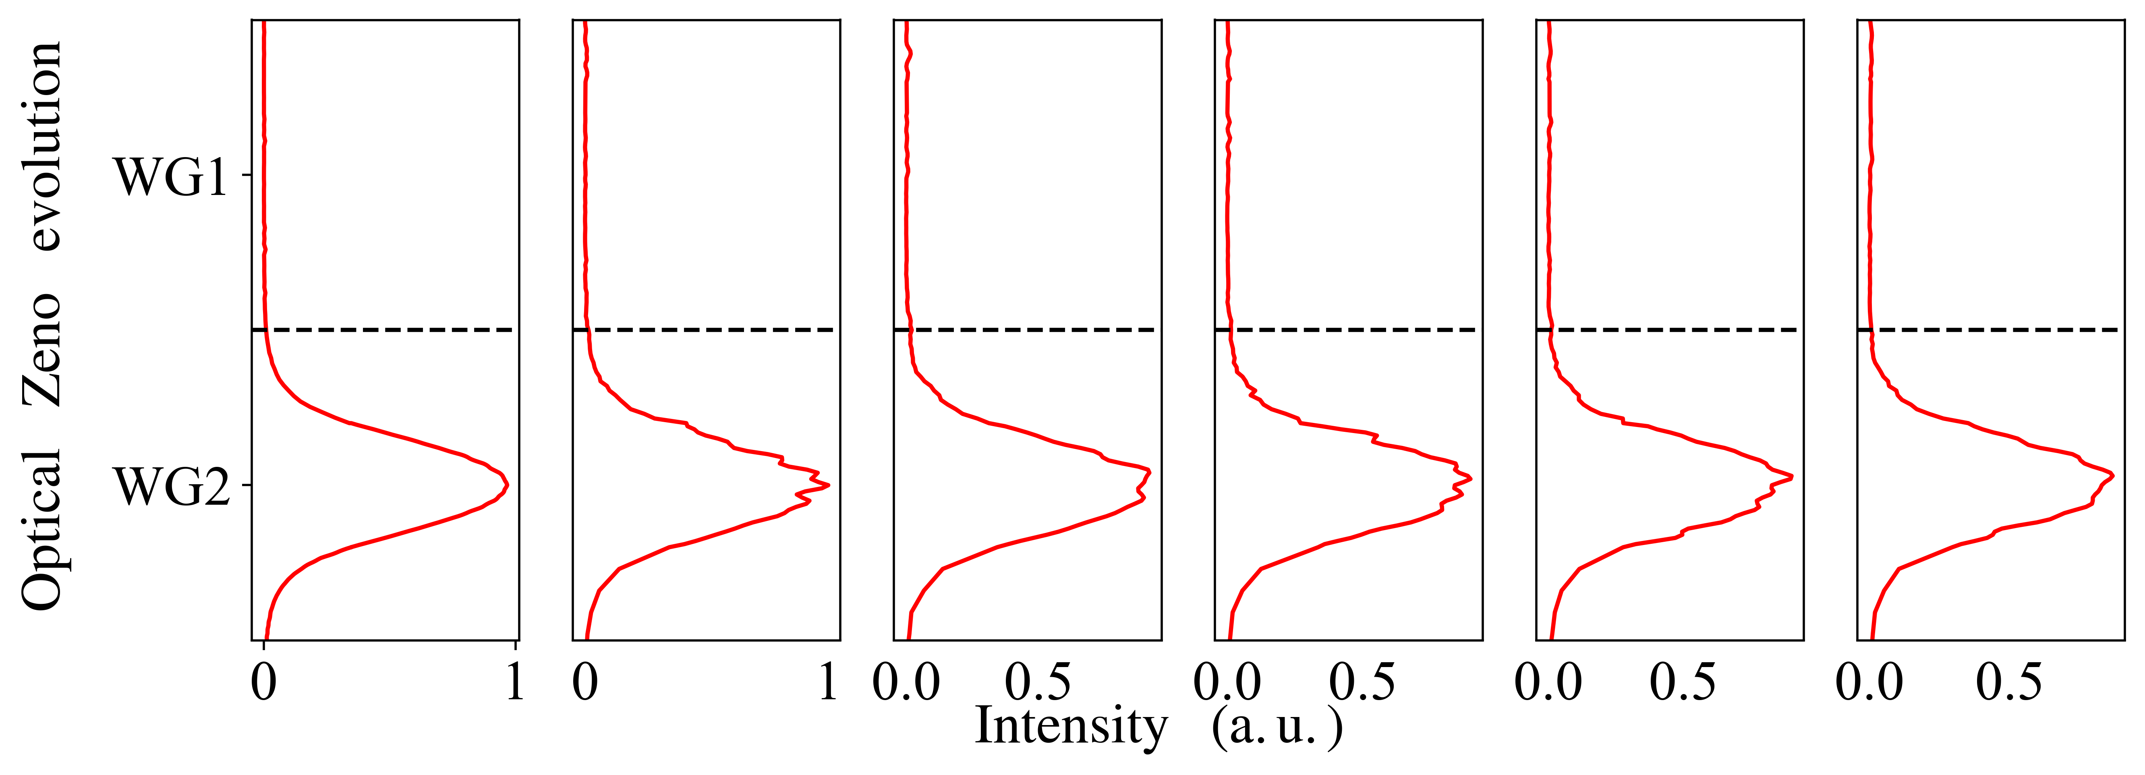
WG1
WG2
M
WG1
WG2
Fig1.c
0
0.2L
0.4L
0.6L
0.8L
L
Z
Fig1.d

Slide 2
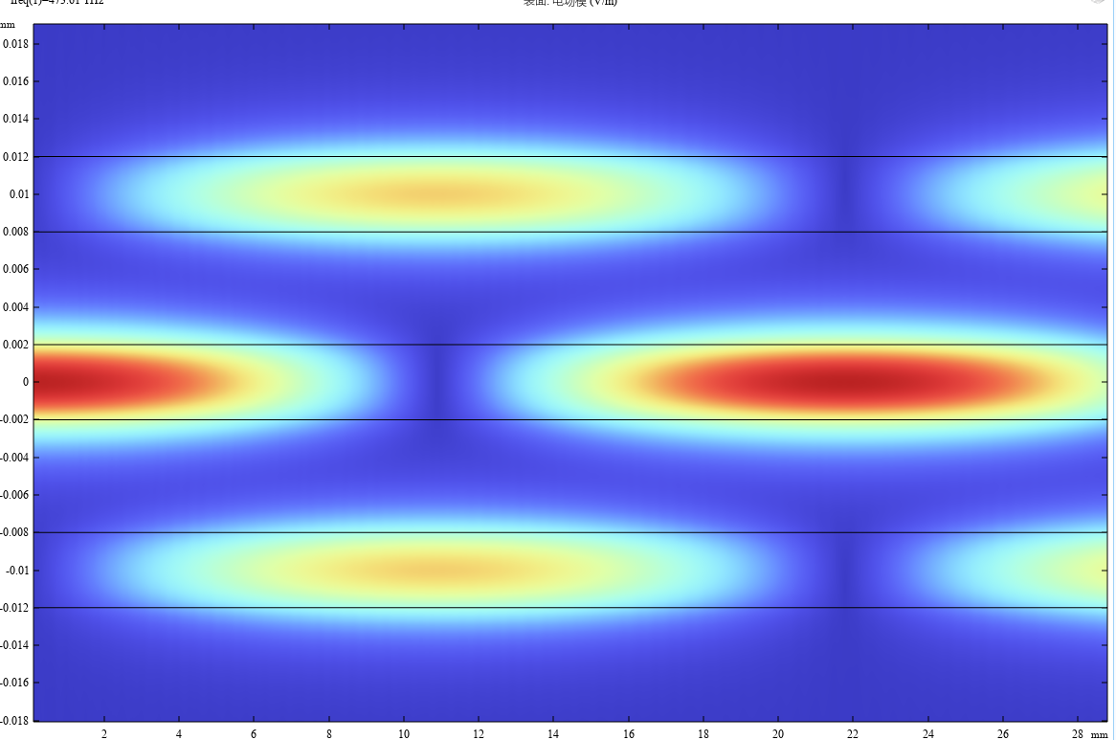
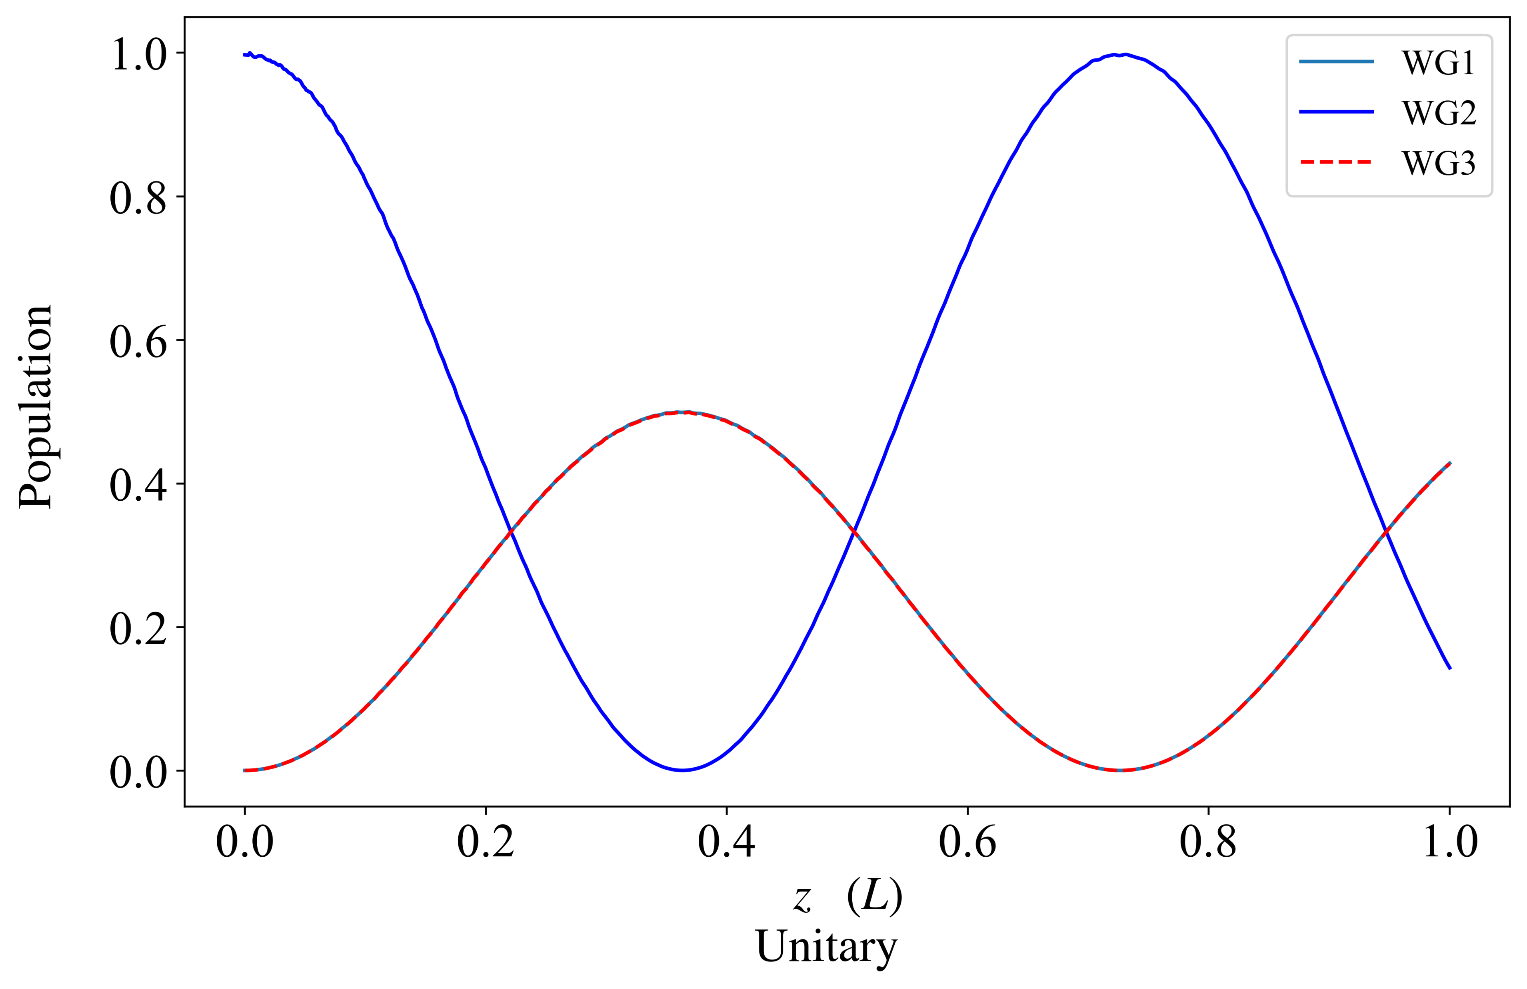
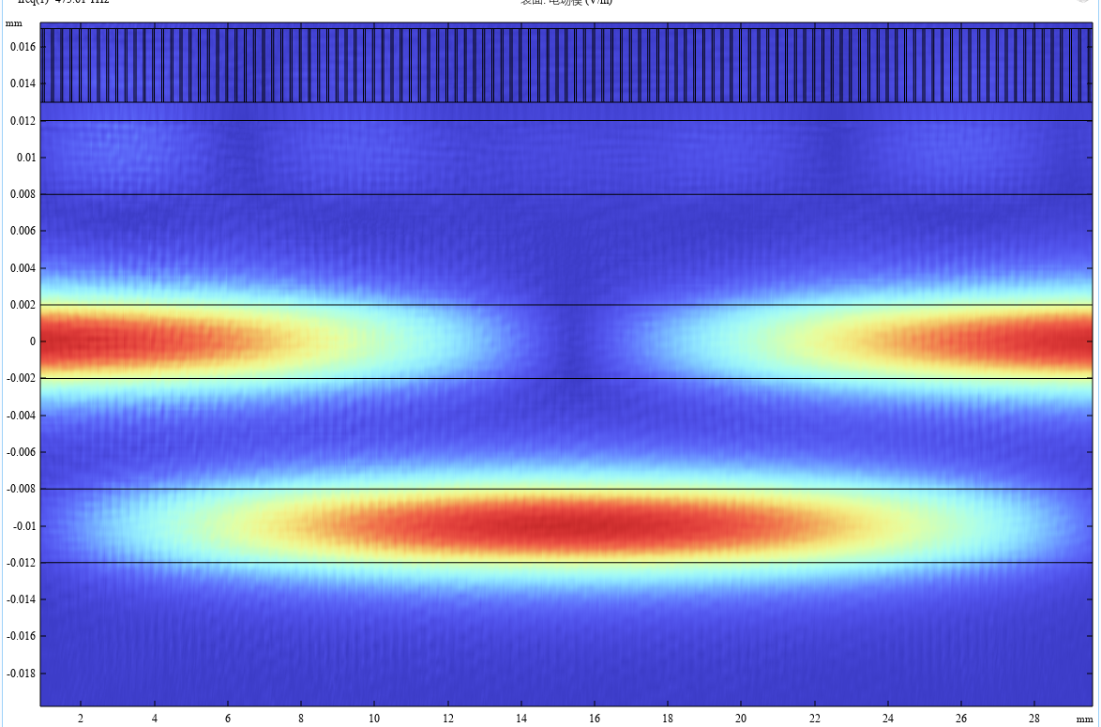
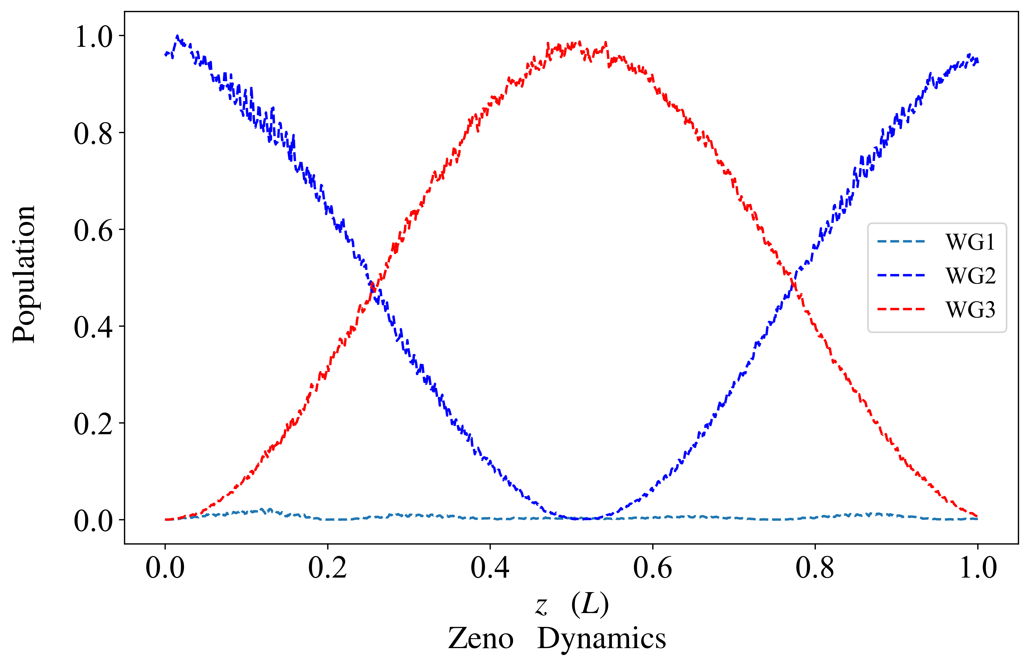
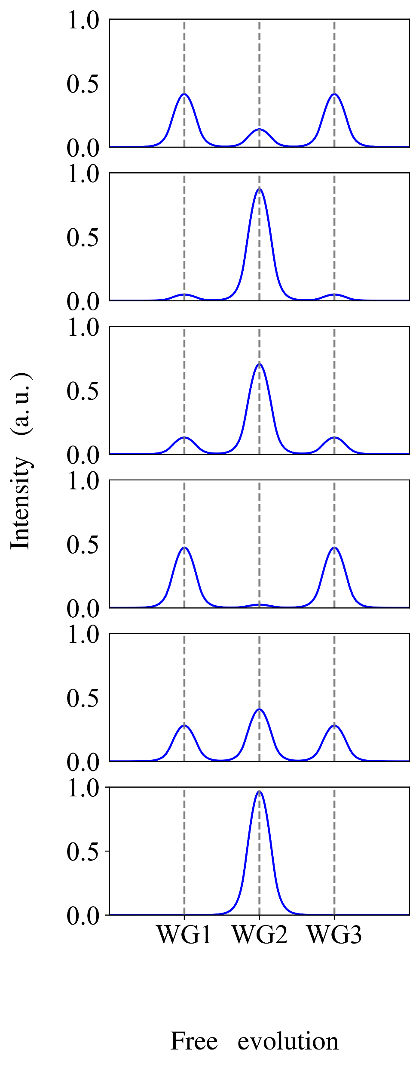
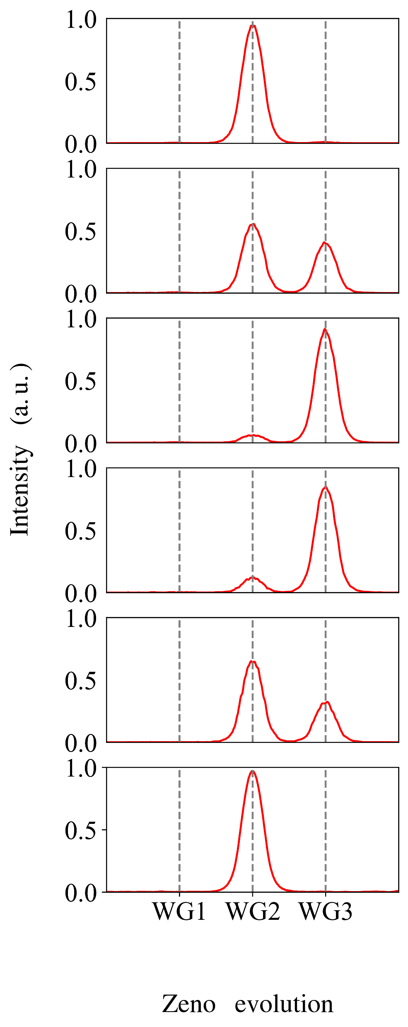
Fig2.b
WG1
WG2
WG3
Fig2.c
WG1
WG2
WG3
Fig2.d
Fig2.e
0
0.2L
0.4L
0.6L
0.8L
L
Z

Slide 3
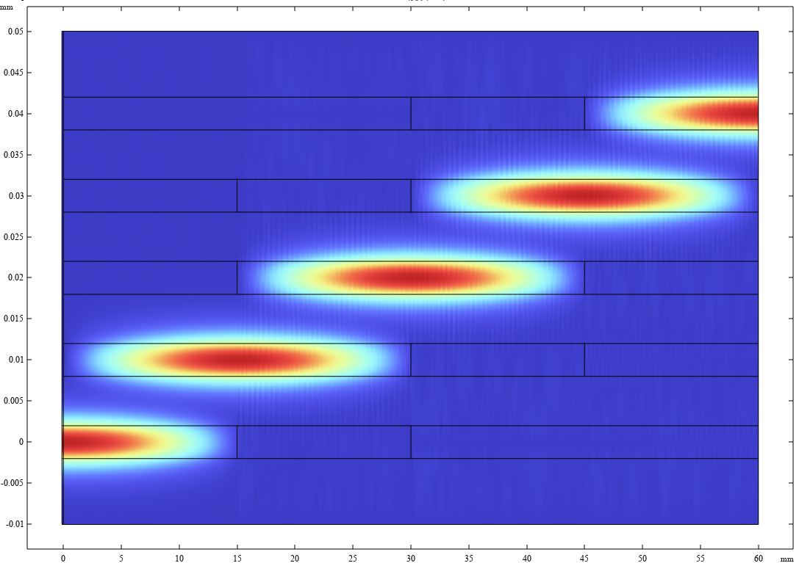
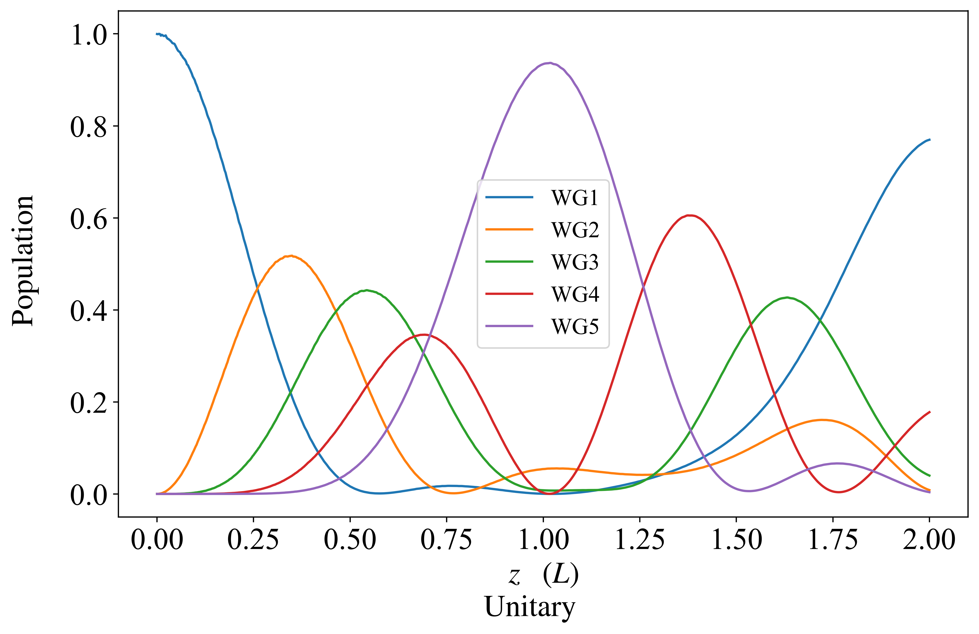
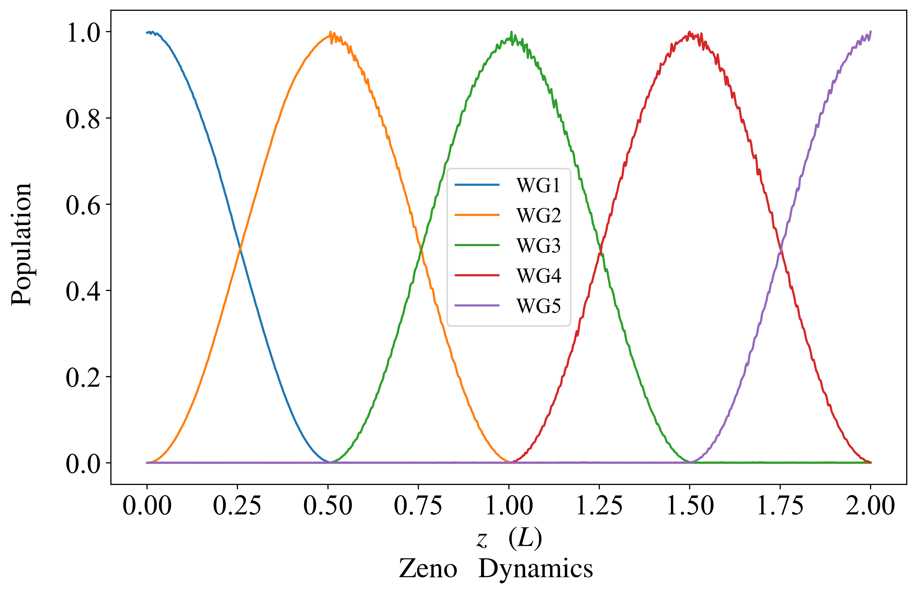
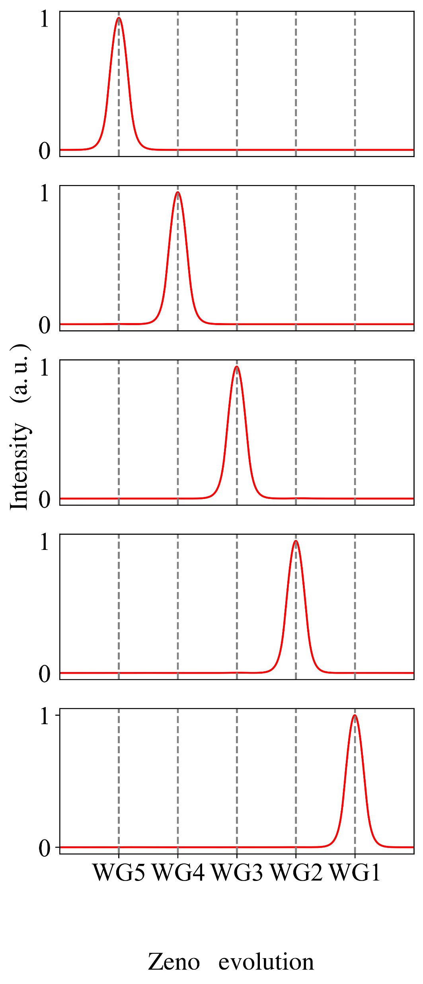
WG1
WG2
WG3
WG4
WG5
Fig3.a
Fig3.b
Z
2L
1.5L
L
0.5L
0
Fig3.c

